Slide 1
Anesthetic Considerations for One Lung Ventilation
Julia E. Linton
York College/ Wellspan Health Nurse Anesthesia Program

Slide 2
Objectives
Review patient case scenario
Review some basic principles of respiratory physiology
Describe indications for and complications with one-lung ventilation
Discuss management strategies for hypoxemia in OLV
Apply principles learned to case scenario
Review difficult airway algorithm and OLV management plan

Slide 3
Patient Scenario
Leroy, 70 year old man, 75 kg
He is scheduled for a wedge resection of his left upper lobe
Does the side of surgery matter?
What do we want to know?
What can we do with that information?
Notes:
CBC/ Chem panel WNL
PFT’s: FEV1/ FVC 67%
ABG (room air)
pH 7.37
PaCO₂ 44
HCO₃ 25
PaO2 83
SaO2 95%
EtCO2 32
PaO2 FiO2 Ratio = 395 on room air
FEV1/FVC 67% what does that tell u about postop? A ratio of <50% predicted is an indication of increased postop complications

Slide 4
Anesthesia for OLV
Indications
Physiologic changes
Accomplishing OLV safely and effectively

Slide 5
Indications for OLV
Absolute vs. Relative
Notes:
The indications for OLV are sometimes referred to as surgical vs non surgical, lung isolation vs lung separation, or most often absolute vs relative
Here we see that infection and bleeding are out top indications – when we absolutely do not want what is happening in one lung to spread to the opposite lung
Our surgical indications fall under the relative category – which is good because it gives us options on how to implement OLV. Absolute indications require a DLT, relative indications generally allow for the use of a DLT or BB

Slide 6
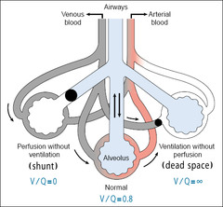
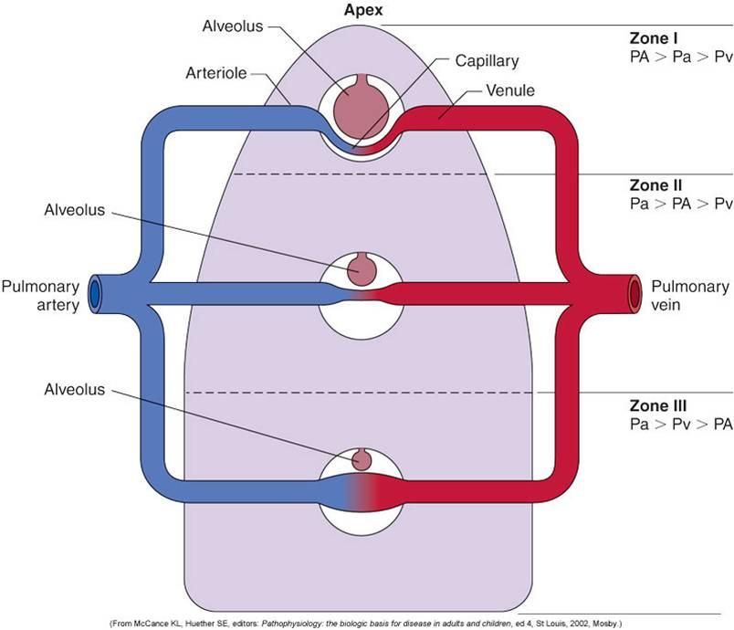
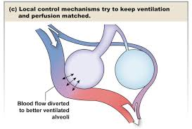
Physiology Review (or preview)
Notes:
First let’s talk about dead space and shunt. Dead space = ventilated not perfused. Shunt = perfused not ventilated.
Zones 1, 2, 3. 1 is dead space, 2 is matched, 3 is shunt.
Lastly, and briefly, lets review hypoxic pulmonary vasoconstriction. We have hypoxemia anywhere else in the body and what happens –vasodilation. Fortunately for us we have HPV in the lungs – so when there are alveoli not getting adequate oxygenation, the hypoxemia causes vasoconstriction of the vasculature around that alveolus and blood flow to the area is limited.
One last question - How does air get to the last 3 generations of airways? Diffusion, not bulk flow

Slide 7
Physiologic Changes
Notes:
The right lung provides 60% of TLV. Which means that something such as a right sided pneumonectomy will have a greater impact postoperatively and carry a higher mortality rate than would the same procedure on the left.
This is a really great chart from the Elisha Case Studies book. It gives a summary of where ventilation and perfusion are highest depending on patient position and condition.
So we can see that in the upright, awake patient VQ is relatively matched.
When we induce anesthesia and turn the patient to the lateral decubitus position, we see that ventilation is better in the non-dependent lung and perfusion is higher in the dependent lung. We end up with a VQ mismatch
What do we think is going to happen when we initiate OLV and stop ventilating that non-dependent lung?
We will end up with a whole lot of perfusion, and not a lot of ventilation. Even though HPV is our friend in this situation and it will decrease some blood flow to the non-ventilated non-dependent lung, there will still be perfusion. We are more perfused, less ventilated which means…shunt. And what we will see is that our biggest challenge will be dealing with that shunt.

Slide 8
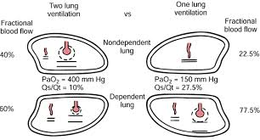
Math
Physiologic Dead Space
Shunt Equation
A-a gradient = PAO₂ – PaO₂
PaO₂/FiO₂ Ratio
<200 often seen in OLV, even to 100
Remember, <125 is not good
Notes:
Normal anatomic dead space is 150ml. Physiologic dead space is dynamic, always changing.
If your dead space is increasing during a case, did your BP drop our did your peak airway pressure go to high = more dead space
Changes that we can expect are that our PaO2/ FiO2 ratio will drop significantly. In OLV, a ratio of 200 is expected as normal, and can drop as low as 125
We also will be creating a much larger shunt. OLV is responsible for a shunt fraction of 20-30%.

Slide 9
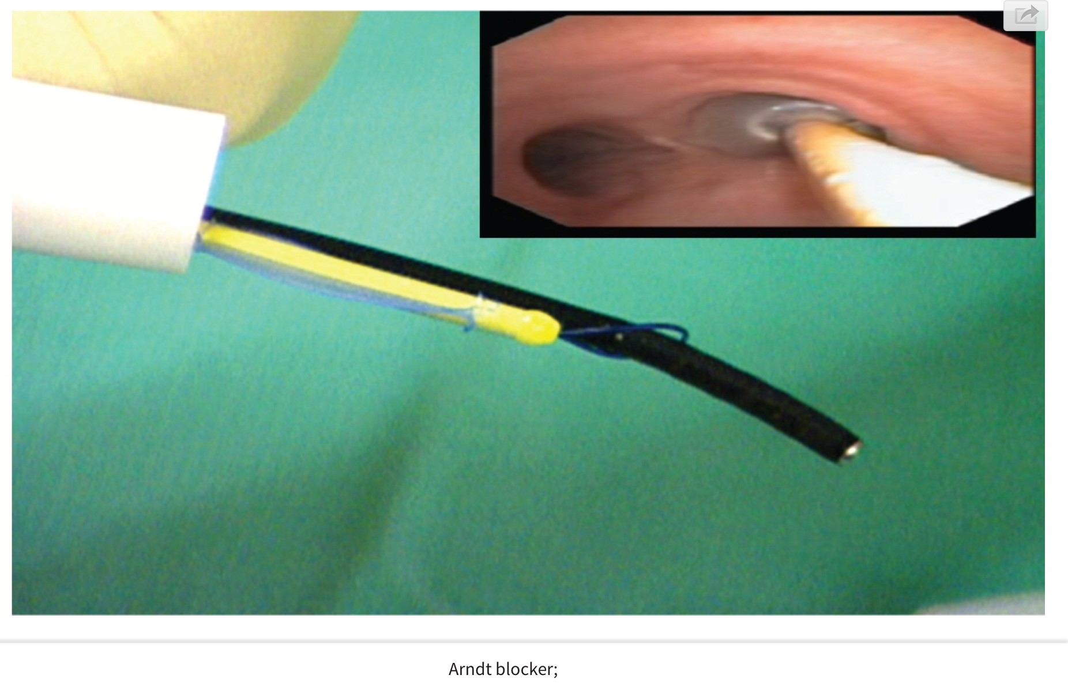
Devices – DLT vs. BB
Double Lumen Endobronchial Tube
Advantages
Only device that provides true lung isolation
Faster time to device placement and lung deflation
Fewer device repositions once in place
Lower peak airway pressures
Disadvantages
More difficult to place
Requires tube exchange if patient requires postoperative ventilation
Bronchial Blockers
Advantages
Can be used down single lumen tube
Provide selective lobar isolation
No difference found in lung collapse time as compared to DLT
Disadvantages (compared to DLT)
Longer time to place device
More repositions after initial placement
Slightly higher mean peak airway pressures
Require FOB to confirm placement

Slide 10
Hypoxemia in OLV
5-10% of cases will have a SaO2 <90%
Shunt fraction during OLV is 20-30%
How do we prevent it or fix it?
Deflate before you need to so you know how they will respond
CPAP to non-dependent lung
PEEP, alveolar recruitment
Two lung ventilation
Clamp blood supply to non-dependent lung
Notes:
CPAP 5-10 cm H20 with high flow from flow meter on AGM
PEEP as tolerated
Alveolar recruitment maneuvers: cycling maneuvers, sustained inflation maneuvers
- Gradually increasing PEEP in a step-wise fashion to overcome closing pressure
- Holding 40 cmH20 for 10 seconds
A study by Kozian et all found that performing ARM BEFORE initiation of OLV improved aeration and decreased atelectasis in the dependent lung
Obviously, you need to stop your patient from becoming hypoxic then troubleshoot the cause

Slide 11
Now we return to our regularly scheduled surgery
Where were we before OLV?
Let’s look at the patient now…
What don’t we like?
What can we optimize and how?
What number on our monitor is going to significantly change when we re-expand the down lung?
Notes:
Look at the patient now…
Sat 93% - okay?
FiO2 .5 – okay?
What do we think our PaO2 is? He started out at a PaO2 of 83 when his Sat was 95%. PaO2 is now 80. Are we happy?
PaO2/FiO2 ratio = 160
Can we optimize this?
Numbers get worse:
pH 7.32
CO2 48
HCO3 23
PaO2 52
Sat 88%
ETCO2 34
FiO2 50%
Optimizing the patient – CPAP, PEEP, alveolar recruitment, TLV
----- Meeting Notes (1/27/15 07:04) -----
What else can we look at for this patient?
What can our A-a gradient tell us?
Alveolar gas equation PAO2 = FiO2 (PB-PH20)-PaCO2/RQ
Our FiO2 is .5
PB = 760 PH2O = 47
PaCO2 48
RQ = 0.825
PA02 = 298 - this is the average of all the alveoli - but not what is happening in every single alveolus
A-a = (Age/4)+4 ~ 21.5
PAO2 = 298 PaO2 = 80
A-a gradient = 218
The gradient can be elevated in R-L shunt, V/Q mismatch, or diffusion abnormality
What do we have? Mismatch, PE?
PE is going to give you a big gradient with a decerasing CO2

Slide 12
Don’t Hate, Ventilate!
Know your patient’s baselines before starting the case
Have plans A, B, C, etc. to deal with complications
Do a trial run of OLV before the surgeon is ready to start – you’ll usually know in 15 minutes if they are going to tolerate it or not
Keep your doc informed when necessary
Trend your numbers
Have a clear set of post-op expectations

Slide 13
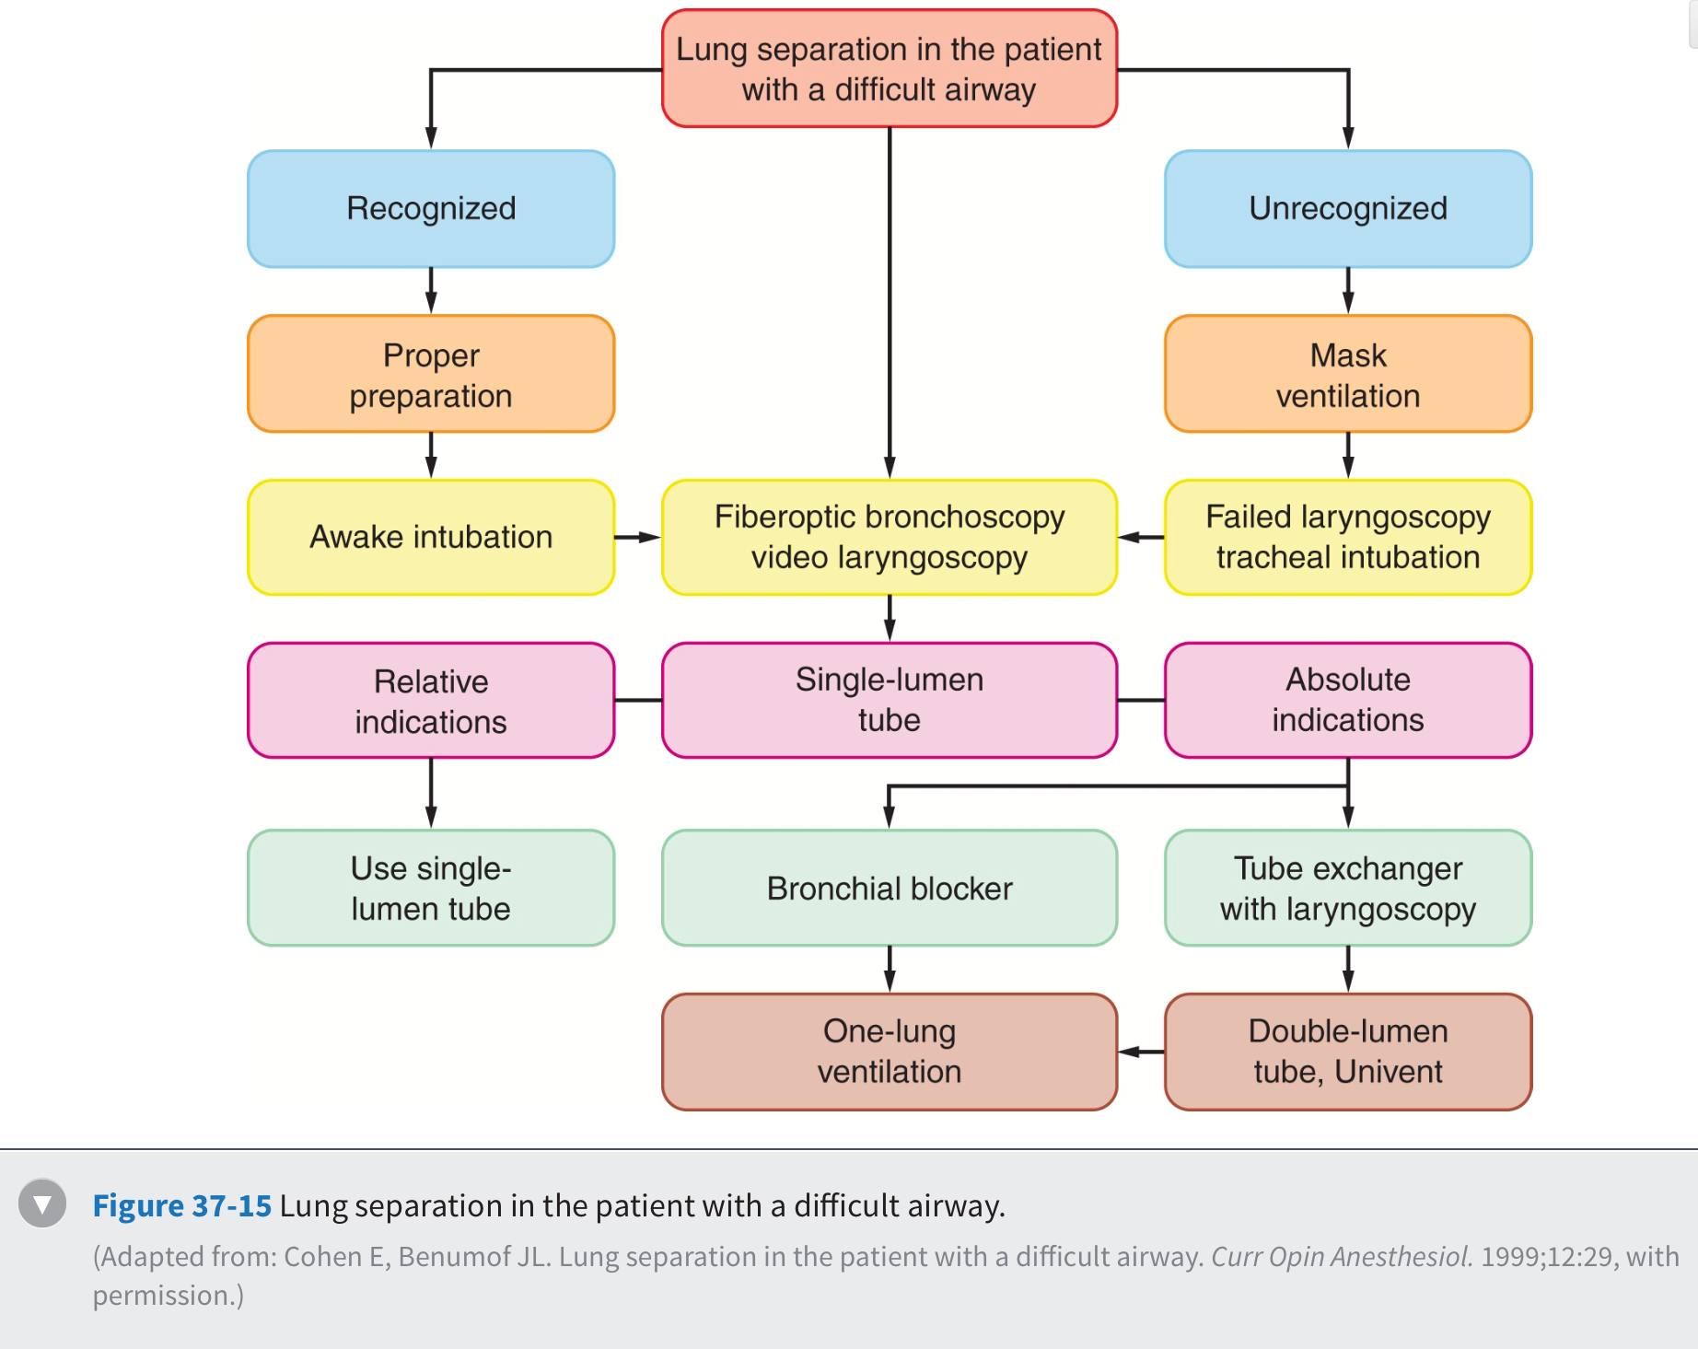
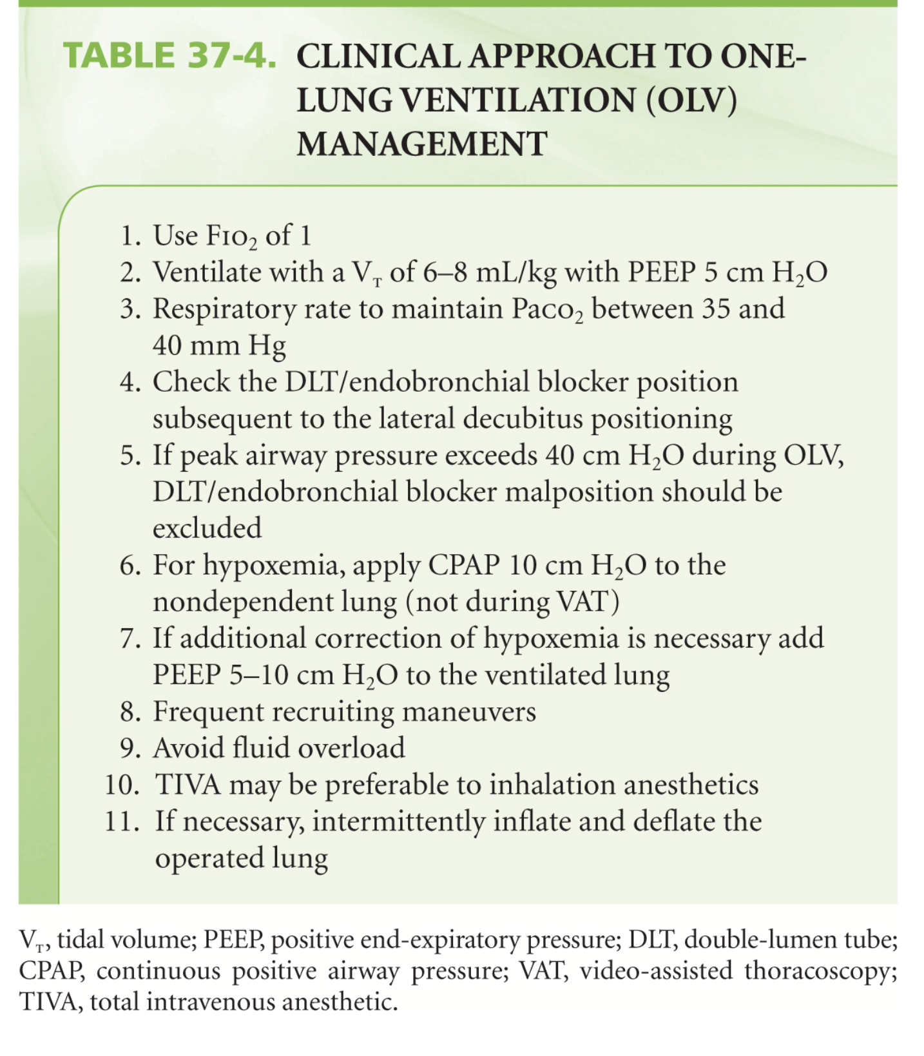
Extra Tidbits

Slide 14
References
Barash, P., Cullen, B., Stoelting, R., Cahalan, M., Stock, M., & Ortega, R. (2013). Philadelphia, PA: Lippincott, Williams, & Wilkins.
Elisha, Sass. (2009). Case Studies in Nurse Anesthesia. Sadbury, MA: Jones and Bartlett.
Karzai, W., & Schwarzkopf, K. (2009). Hypoxemia during one-lung ventilation: Prediction, prevention, and treatment. Anesthesiology 110 (6), 1402-1411.
Kozian, A., Schiling, T., Schutze, H., Senturk, M., Hachenberg, T., & Hedenstierna, G. (2011). Ventilatory protective strategies during thoracic surgery: Effects of alveolar recruitment maneuver and low-tidal volume ventilation on lung density distribution. Anesthesiology, 114 (5), 1025-1035.
Narayanaswamy, M., McRae, K., Slinger, P., Dugas, G., Kanellakos, G., Roscoe, A., & Lacroix, M. (2009). Choosing a lung isolation device for thoracic surgery: A randomied trial of three bronchial blockers versus double-lumen tubes. Anesthesia & Analgesia, 108 (4), 1097-1101.
Roze, H., Lafargue, M., & Ouattara, A. (2011). Case scenario: Management of intraoperative hypoxemia during one-lung ventilation. Anesthesiology 114 (1), 167-174.
Ueda, K., Goetzinger, C., Gauger, E., Hallam, E., & Campos, J. (2012). Use of bronchial blockers: A retrospective review of 302 cases. Journal of Anesthesia 26, 115-117.

Slide 15
Questions…

