Slide 1
Mitochondrial Disease & its Anesthetic Considerations
Stephen Okoth BSN, SRNA (Sr.)
York College of PA/Wellspan Health NAP

Slide 2
Objectives
Discuss the structure of the Mitochondrion
Discuss the main function of the Mitochondrion
Detecting and Diagnosing mitochondrial diseases
Treatment of mitochondrial diseases
Anesthetic considerations for patients with mitochondrial diseases
Case Review

Slide 3
Endosymbiotic theory
http://philschatz.com/biology-concepts-book/contents/m45513.html

Slide 4
Mitochondrion

Slide 5
Mitochondrial vs. Nucleic DNA
The mitochondrial genome is circular, whereas the nuclear genome is linear
The mitochondrial genome is built of 16,569 DNA base pairs, whereas the nuclear genome is made of 3.3 billion DNA base pairs.
The mitochondrial genome contains 37 genes that encode 13 proteins, 22 tRNAs, and 2 rRNAs.
The small mitochondrial genome are unable to produce all of the proteins needed for functionality; thus, mitochondria rely heavily on imported nuclear gene products.

Slide 6
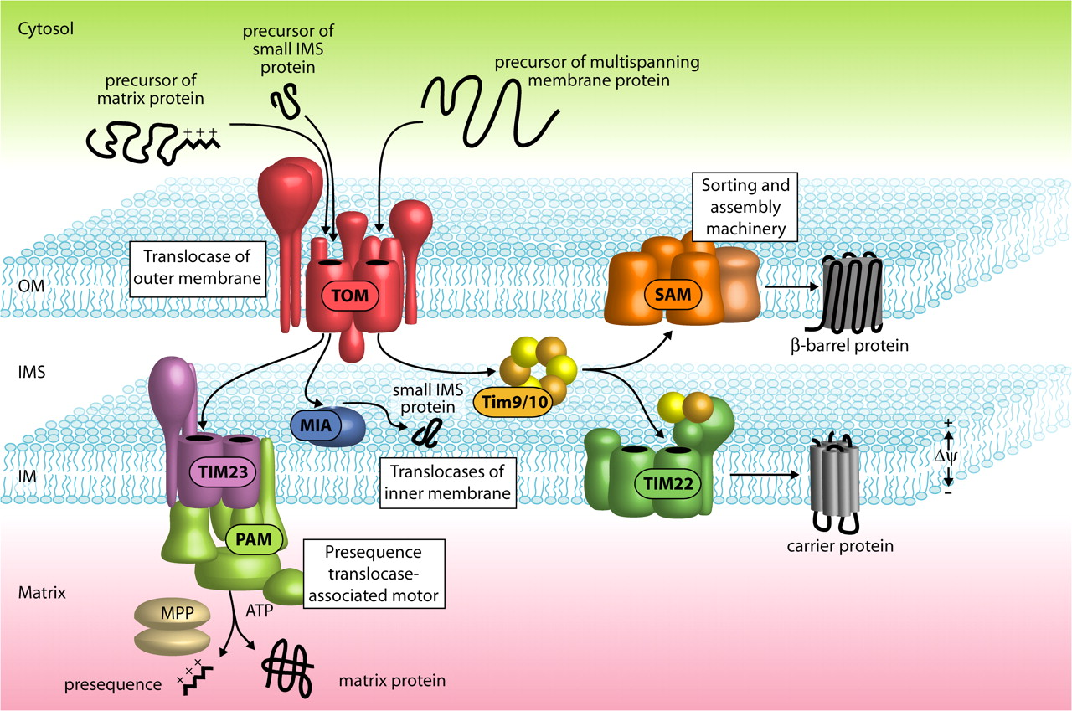
Mitochondrial import pathways for precursor proteins.
Stephan Kutik et al. J Cell Biol 2007;179:585-591
The Rockefeller University Press
Notes:
Mitochondrial import pathways for precursor proteins. Nuclear-encoded mitochondrial proteins are imported by the TOM complex. Subsequently, they follow different pathways. Presequence-carrying proteins are transported by the TIM23 complex and the motor PAM into the matrix, where mitochondrial processing peptidase (MPP) cleaves off the presequences. Small proteins of the intermembrane space (IMS) are imported via the mitochondrial intermembrane space assembly machinery (MIA). β-barrel precursors of the outer membrane (OM) are transferred by the Tim9–Tim10 chaperone complex from TOM to SAM. Precursors of inner membrane (IM) carriers use Tim9–Tim10 for transfer to the TIM22 complex that drives insertion into the inner membrane.

Slide 7
Mitochondrial Gene Inheritance
http://thumbs.dreamstime.com/z/mitochondrial-diseases-inheritance-scheme-disease-illustration-52301092.jpg

Slide 8
Fission vs. Fussion

Slide 9
Function
Energy production in the form of ATP
Thermogenesis
Storage and Regulation of Calcium Ions
Apoptosis
Cholesterol and Neurotransmitter Metabolism
Detoxification of Ammonia

Slide 10
Cellular Respiration

Slide 11
ATP Production
Ref: http://www.tritec-inc.org/science-units/energy2013-KeyToLife/images/pelosi/Picture1_krebs.jpg

Slide 12
Oxidative phosphorylation
Ref: https://sites.google.com/site/accessrevision/biology/cell-form-and-function/cellular-respiration

Slide 13
Mitochondrial diseases
clinical and biochemical disorders resulting from dysfunction of the mitochondria. First clinically described in 1960
This results in a lack of cellular energy to perform various functions and in the accumulation of byproducts that impair or destroy the cell itself
They can be caused by mutation of genes encoded by either nuclear DNA or mitochondrial DNA (mtDNA)
Mitochondrial disorders may present at any age.
There is an estimated incidence of 1 in 4000 live births suffering from mitochondrial disease in the United States.
These diseases have varying etiologies and are often very difficult to classify

Slide 14
Clinical Manifestation
https://universe-review.ca/I10-05-mito02.gif

Slide 15
Signs and Symptoms
loss of motor control
muscle weakness and pain
gastro-intestinal disorders and swallowing difficulties
poor growth
cardiac disease
liver disease
diabetes
respiratory complications
seizures
visual/hearing problems
lactic acidosis
developmental delays
susceptibility to infection.

Slide 16
Classifying the diseases
Scientists have discovered over 40 different mitochondrial diseases.
Early on diseases would be classed by clinical syndrome e.g
CPEO: chronic progressive external ophthalmoplegia
MELAS: mitochondrial encephalopathy with lactid acidosis and stroke like episodes
MERRF: myoclonic epilepsy with ragged red fibers
LHON: Leber hereditary optic neuropathy

Slide 17
Classifying the diseases
Phenocopies
Genocopies
diseases that are caused by the same mutation but which may not look the same clinically
different mutations in mtDNA and nDNA can lead to the same diseases.
primary mitochondrial disease: a mutation in the mitochondria causes the organelle to malfunction and produce symptoms.
secondary mitochondrial disease: genetic alteration is present, but does not produce any symptoms of disease until an external environmental force triggers mitochondrial dysfunction.

Slide 18
Causes of Mitochondrial diseases
The major cause of the disease is gene inheritance. Either nucleic or mitochondrial genes
The other cause is mitochondrial toxins. Various agents including commonly used drugs have been found to be toxic to the mitochondria.

Slide 19
Mitochondrial toxins

Slide 20
Mitochondrial toxins

Slide 21
Mitochondrial Toxins

Slide 22
Diagnosing
Mitochondrial diseases are difficult to diagnose. Referral to an appropriate research center is critical.
Combination of clinical observations, laboratory evaluation, cerebral imaging, and muscle biopsies are used to aid diagnosis.
A single blood or urine lab test with normal results does not rule out or confirm a 100% diagnosis of mitochondrial disease.
Genetic testing can be done to assess for known mutations

Slide 23
Who knew…..

Slide 24
Muscle Biopsy
When treated with a dye that stains mitochondria red, muscles affected by mitochondrial disease often show ragged red fibers — muscle cells (fibers) that have excessive abnormal mitochondria.
Other stains can detect the absence of essential mitochondrial enzymes in the muscle.
It is also possible to extract mitochondrial proteins from the muscle and measure their activity.

Slide 25
Ragged Red Fibers

Slide 26
Treating mitochondrial disease
There is no definitive cure for mitochondrial diseases
Therapy is aimed at alleviating symptoms, maintaining optimal health, using preventive measures to mitigate symptom worsening during times of physiologic stress, and avoiding mitochondrial toxins.
The use of antioxidant supplements aimed at reducing reactive oxygen species that are produced in increased amounts in this disease.

Slide 27
Exercise Training

Slide 28
Anesthetic Considerations
The heterogeneity of the diseases makes it very difficult to have the one perfect anesthetic.
The lack of clinical trials investigating the effects of anesthetic agents in patients with mitochondrial disease has limited the anesthetists ability to deliver the perfect anesthetic.
Adverse effects on mitochondrial function of many agents used in anesthesia have been documented in vitro, but there are few reports of adverse events in vivo.
The theoretical effects of any agent need to be considered in the general context of any one patient’s medical history.

Slide 29
Clinical Trials

Slide 30
Clinical Trial

Slide 31
Pre-op Evaluation
Multi-system involvement in these disorders necessitates a thorough pre op evaluation including family history.
Determine degree of neurological and musculoskeletal compromise.
Careful cardiac assessment including EKG and echocardiography.
Renal and Hepatic function
All clinical manifestations of MD, including seizures, arrhythmias, cardiac dysfunction, myopathy, and endocrinopathies, can be worsened by trauma, illness, or surgical stress.
Duration of NPO status

Slide 32
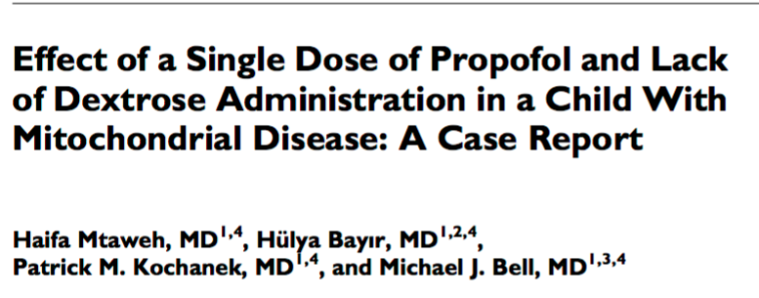
Local, regional or general?

Slide 33
Pre Medication
Avoid lactated ringers solution which could increase lactate load.
Avoid respiratory depressants, patients have inadequate response to hypoxia or hypercapnia.

Slide 34
Induction
Sensitivity to induction agents
Ketamine and barbiturates inhibit complex I
Etomidate inhibits complex I and complex II
Propofol has been shown to be most problematic as it inhibits complex I and IV as well as disrupting fatty acid transport. Conflicting opinions however persist on single dose use.

Slide 35
PRIS
Propofol-related infusion syndrome (PRIS) is a rare yet often fatal syndrome that has been observed in critically ill patients receiving propofol for sedation.
Doses greater than 4mg/kg/hr for durations longer than 48 hours place a patient at risk for PRIS.
PRIS is characterized by severe unexplained metabolic acidosis, arrhythmias, acute renal failure, rhabdomyolysis, hyperkalemia, and cardiovascular collapse.
The exact pathophysiology of PRIS remains to be determined, but is thought to be related to impaired tissue metabolism.
Risk factors for developing PRIS include sepsis, severe cerebral injury, and high propofol doses.
Early recognition of the manifestations is the key to managing PRIS. If is suspected, propofol should be discontinued and an alternative sedative agent initiated. General measures to support cardiac and renal function should be initiated promptly in patients with suspected PRIS.

Slide 36
Muscle Relaxation
There is conflicting evidence on the use of muscle relaxants.
It is generally thought that there could be an increased sensitivity to non depolarizing muscle relaxants.
Succinylcholine has been used successfully but is often avoided as these patients are thought to have a susceptibility to MH and could be subject to hyperkalemia if they are inactive.

Slide 37
Analgesia
Beneficial in minimizing oxygen demand
However impaired respiratory control necessitates that opioids are used with caution.
Remifentanil is thought to have less effect on mitochondrial energetics than fentanyl which is preferred over morphine
L.A’s have been shown to inhibit complex I & acylcarnitine transferase. Lidocaine<ropivicaine<bupivacaine

Slide 38
Intra-op
Monitor blood glucose especially in long cases.
Less tolerance to hypoxia
Maintain normothermia. Hypothermia further depresses mitochondrial activity.
Keep patient hydrated

Slide 39
Emergence
May not be a good candidate for deep extubation
Consider leaving on ventilator or going to PACU on ventilator if far from baseline.

Slide 40
Post-Op
Crucial period for these patients
Exacerbation of mitochondrial disease may not be immediate.
Warrants patients to be monitored longer
Do not transfer from OR to stage 2 recovery.

Slide 41
Case Review
46 year old male pt. 6’2” 80kg BMI 22.6 scheduled for vascular access port.
PMH: recent diagnosis of genetically associated mitochondrial disease, industrial injury that required transplantation of toes to right hand.
PSH: appendectomy, tonsillectomy, depression, chronic pain, GERD, left heart catheterization
Allergies: Penicillin

Slide 42
Case review cont’d
Patient states he has been feeling progressively weak and fatigued since July 2013. work up done for lymes dz, adrenal insufficiency and myasthenia gravis all negative.
Pt muscle biopsy in 2009 which showed no pathology.
Meds: L-carnitine, L-arginine, vit c, vit d3, riboflavin, duloxetine, ubiquinone, dextrose 30mg po q morning,

Slide 43
What did we do?
Switched patient’s IV fluids from LR to 0.9% NSS which was already running in the pre operative area.
Checked patients blood glucose in pre op.
Made anesthesiologist and surgeon aware of concerns with patient’s disease process.

Slide 44
Anesthesia plan
Upon deliberation, consensus was reached to perform a MAC anesthetic
Anesthesia start time at 17:15 due to delay in surgeons other cases
Midazolam 2mg, ketamine 20mg, precedex infusion 1mcg/kg bolus then started infusion (total 98mcg), fentanyl 35mcg.
Anesthesia stop time 18:13. SBP 90-130’s, HR 70’s NSR
No untoward events. Intra op. Pt. was discharged home later that evening.

Slide 46
References
Alberts, B., Johnson, A., Lewis, J., Raff, M., Roberts, K., & Walter, P. (2002). Molecular Biology Of The Cell (4th Edition ed.). New York, New York: Garland Science.
Chial, H., & Craig, J. (2008). mtDNA and Mitochondrial Diseases. Nature Education , 1 (1), 217.
Chinnery, P. (2000). Mitochondrial Disorders Overview. GeneReviews .
Cooper, G. (2000). The Cell: A Molecular Approach (2nd Edition ed.). Sunderland , MA: Sinauer Associates.
Cooper, M., & Fox, R. (2003). Anesthesia for corrective spinal surgery in a patient with leigh disease. Anesthesia & Analgesia , 97 (5), 1539-1541.
El-Hattab, A., & Scaglia, F. (2016, March). Mitochondrial Cytopathies. Cell Calcium .
Finsterer, J., & Segall, L. (2010). Drugs interfering with mitochondrial disorders. Drug and Chemical Toxicology , 33 (2), 138-151.
Finsterer, J., Haberler, C., & Schmiedel, J. (2005). Deterioration of kearns-sayre syndrome following articaine administration for local anesthetic. Clinical Neuropharmacology .
Hall, J., & Guyton, A. (2011). Guyton and Hall Textbook of Medical Physiology (12th ed.). Philadelphia: Saunders Elsevier.
Koenig, M. (2008). Presentation and Diagnosis of Mitochondrial Disease in Children. Pediatric Neurology , 38 (5), 305-313.
Krane, E., & Williamson, J. (2011). Anesthesia for Patients with Mitochondrial Disease.

Slide 47
References
Kuhlbrandt, W. (2015). Structure and function of mitochondrial membrane protein complexes. BMC Biology , 13.
Mtaweh, H., Bayir, H., Kochanek, P., & Bell, M. (2014). Effect of a single dose of propofol and lack of dextrose administration in a child with mitochondrial disease. Journal of Child Neurology , 29 (8), NP40-NP46.
Niezgoda, J., & Morgan, P. (2013). Anesthetic Considerations in Patients with Mitochondrial Defects. Pediatric Anesthesia , 23 (9), 785-793.
Parikh, S., Saneto, R., Falk, M., Anselm, I., Cohen, B., & Haas, R. (2009). A modern approach to the treatment of mitochondrial disease. Current Treatments in Neurology , 11 (6), 414-430.
Rivera-Cruz, B. (2013). Mitochondrial Diseases and Anesthesia: a Literature Review of Current Opinions. AANA Journal , 81 (3), 237-243.
Scheffler, I. (2007). Mitochondria (2nd ed.). Hoboken: Wiley.
Sirrs, S., Duncan, P., & O'Riley, M. (2010). Anesthetic Considerations in Mitochondrial Diseases. Retrieved March 1, 2016, from United Mitochondrial Disease Foundation: www.umdf.com
UMDF. (n.d.). understanding mitochondrial disease. Retrieved February 17, 2016, from United Mitochondrial Disease Foundation: umdf.org
Wallace, J., & Perndt, H. (1998). Anesthesia and mitochondrial disease. Paediatric Anesthesia , 249-254.

