Slide 1
Enhanced Recovery After Surgery
Leah E. Baumgardner, RN, BSN

Slide 2

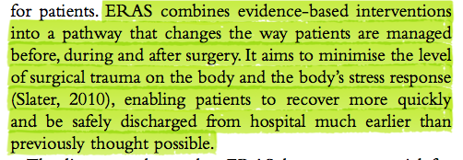
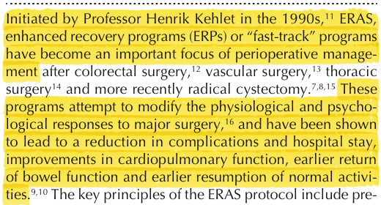
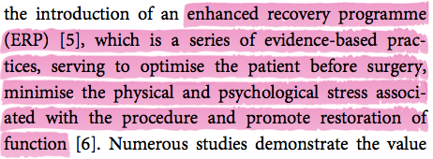
Dr. Henrik Kehlet

Slide 5
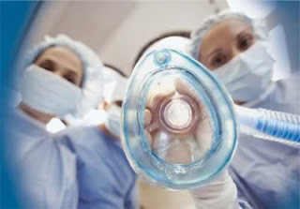

Slide 6

ERAS

Slide 7


Slide 11
Conventional open vs. Laparoscopic
Complication rate after resection 15-20%
LOS 5-6 days (COST trial) and 8.5-9.3 days (COLOR trial)
Reasons for continued LOS: PAIN, NAUSEA, PERSISTANT ILEUS

Slide 12


Slide 14
GOAL: earlier return of GI function and reduced hospital LOS r/t POI
Little evidence to support NPO after MN day before surgery
ERAS protocol: solid food up to 6 hours prior to surgery and clear liquids 2 hours before surgery; “carb loading” 400mL of hypo-osmolar maltodextrin drink 3 hours before surgery

Slide 15
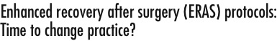
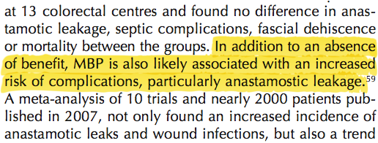

Slide 16
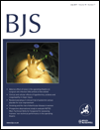
Multicentre randomized clinical trial of mechanical bowel preparation in elective colonic resection
British Journal of Surgery Vol 94, Issue 6, pg 689-695, June 2007
Background:
RCT assessed whether preoperative MBP is beneficial in elective colonic surgery.
Results:
There were no significant differences in overall complications between the two groups: cardiovascular complications occurred in 5·1 and 4·6 per cent respectively, general infectious complications in 7·9 and 6·8 per cent, and surgical-site complications in 15·1 and 16·1 per cent. At least one complication was recorded in 24·5 per cent of patients who had MBP and 23·7 per cent who did not.
Conclusion:
MBP does not lower the complication rate and can be omitted before elective colonic resection

Slide 17
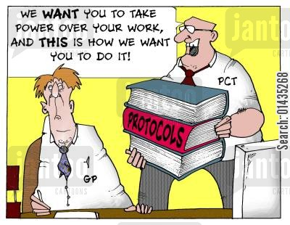

Slide 19
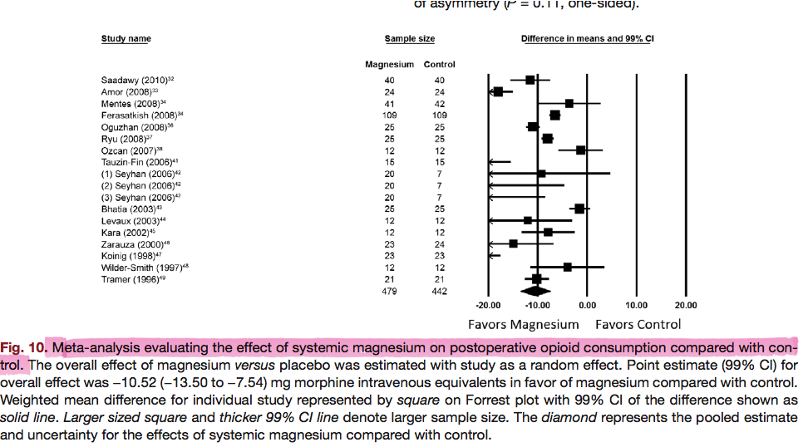

Slide 21
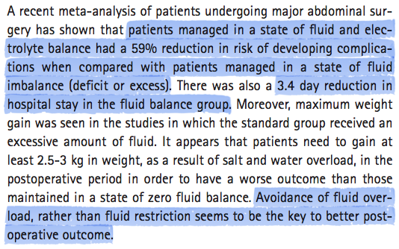

Slide 22
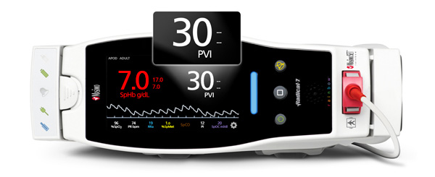
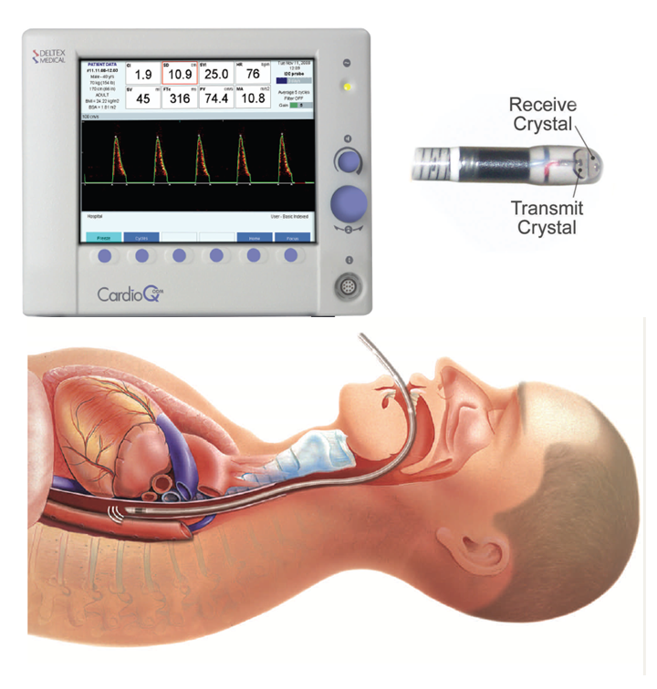
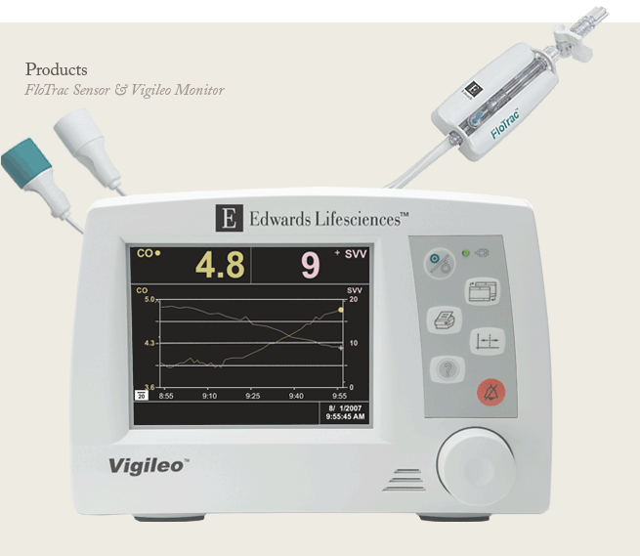
PVI
Pleth Variability Index
Esophageal Doppler Monitor
CardioQ
FloTrac Sensor and Vigileo Monitor
Stroke Volume Variance

Slide 23
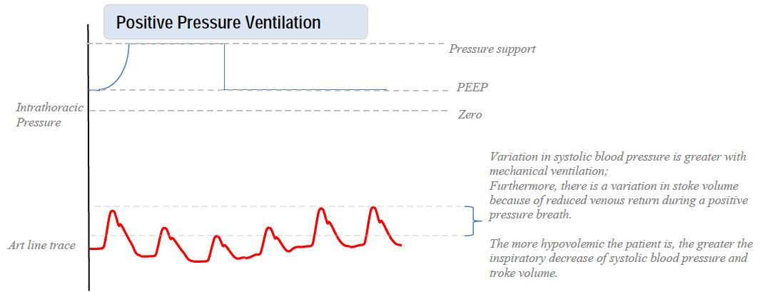

Slide 24

Pre-Operative
Clear Fluids (Gatorade) up to 2 hours before induction of anesthesia Multimodal Analgesia: Celecoxib 400mg PO; Gabapentin 600mg PO; Tylenol 975mg PO IV catheter placed but no IV fluids given in short-stay
Intraoperative
Duramorph 100mcg spinal pre-induction SQH given immediately after the spinal No intraop opiods without attending approval Induction: Propofol, Ketamine, Mg++ 30mg/kg (over 10 min) Dexmedetomidine IV analgesia: Lidocaine gtt (continued into PACU) and Ketamine gtt No Tylenol/Ketorolac Goal-Directed fluids guided by Pleth Variability Index Vt 6-8mL/kg using 100% FiO2
PACU
Consider Ketamine for rescue pain; opiods ok for breakthrough pain Lidocaine gtt for all patients – 1mg/kg/hr Enoxaprin in the AM of POD1

Slide 25



Slide 26

Patient education is important with the ERAS program, so we educate our patients about their care and what they’ll be going through,” said Dr. Gan, whose group presented its findings at the 2013 annual meeting of the International Anesthesia Research Society and the 2013 annual meeting of the American Society of Anesthesiologists
“Preoperatively, instead of starving them for six to eight hours, we actually give them a carbohydrate drink up to two hours before surgery. We use an epidural for every case, whether the procedure is open or laparoscopic, plus multimodal analgesia with IV acetaminophen and NSAIDs
As part of the program, patients undergo esophageal Doppler monitoring (Cardio Q, Deltex) to track their fluid management
Patients are encouraged to start consuming fluids the night of surgery, and solid food the following day. Early ambulation is also a key component of the ERAS program

Slide 28
Information Provision
  “…reaching a balance between over- and under-informing patients…be attentive to their individual needs”
Inpatient Experiences
  “the short LoS [caused] minimal disruption to their lives [and] home was better for recovery…”
Home Recovery Experiences
  “…transfers much of the emphasis of the recovery period to the patients’ home environment…relied heavily on social support…ambiguity of social services in the community and how to access them…did not know who to contact for help”
Psychological/Emotional Experiences
  “ERAS has increased the responsibility on patients for their own care…”

Slide 29
Results
Median age was 74 years, with 20 patients in ASA group III-IV. Normal gastrointestinal function (defecation) occurred within 48 hours in 57 patients, and the median hospital stay was 2 days, with 32 patients staying 2 days after surgery. There were no cardiopulmonary complications. The readmission rate was 15%, including two patients with anastomotic dehiscence (one treated conservatively, one with colostomy); other readmissions required only short-term observation.

Slide 30

A Prospective Comparison of a Noninvasive Cardiac Output Monitor Versus Esophageal Doppler Monitor for Goal-Directed Fluid Therapy in Colorectal Surgery Patients
Waldron, Nathan H.; Miller, Timothy E.; Thacker, Julie K.;
Anesthesia & Analgesia May 2014
Table. Adherence to the Early Recovery After Surgery (ERAS) Program Significantly Improved Patient Outcomes
Non-ERAS ERAS P Value
Total ERAS Fully ERAS Partially ERAS Non-ERAS vs. ERAS
Length of stay (mean, median) 8.4 (7) 6.0 (5) 5.7 (4.5) 6.3 (5) <0.001
30-day readmission 20.2% 8.8% 5.4% 12.7% 0.012
Postoperative crystalloid use (median, L) 10.5 4.6 4.7 3.8 <0.001
Postoperative colloid use (median, L) 0 0.25 0.25 0.15 >0.05
Perhaps not surprisingly, mean total hospitalization costs were $3,640 (15.8%) lower for ERAS patients ($19,344) than non-ERAS patients ($22,984). These differences reached statistical significance with respect to costs for lab tests ($856 vs. $1,172; P=0.011) and chest x-rays ($135 vs. $262; P=0.046), but not overall.

Slide 31
Reduced Length of Hospital Stay in Colorectal Surgery after Implementation of an Enhanced Recovery Protocol
Miller, Timothy et. al
ANESTHESIA & ANALGESIA MAY 2014
METHODS: Data were collected from consecutive patients undergoing open or laparoscopic colorectal surgery during 2 time periods, before and after implementation of an ERAS protocol. Data collected included patient demographics, operative, and perioperative surgical and anesthesia data, need for analgesics, complications, inpatient medical costs, and 30-day readmission rates.
RESULTS: There were 99 patients in the traditional care group, and 142 in the ERAS group. The median length of stay (LOS) was 5 days in the ERAS group compared with 7 days in the traditional group (P < 0.001). The reduction in LOS was significant for both open procedures (median 6 vs 7 days, P = 0.01), and laparoscopic procedures (4 vs 6 days, P < 0.0001). ERAS patients had fewer urinary tract infections (13% vs 24%, P = 0.03). Readmission rates were lower in ERAS patients (9.8% vs 20.2%, P = 0.02).

Slide 32
Kehlet, H., & Dahl, J. (2003). Anaesthesia, surgery, and challenges in postoperative recovery. Lancet, 362(9399), 1921-1928.
Kehlet, H., & Wilmore D.W. (2002). Multimodal strategies to improve surgical outcome. American Journal of Surgery, 183, 630-641.
Duke Medicine. (2014, April 24). New approach for surgery patients cuts hospital stays, costs. ScienceDaily. Retrieved May 6, 2014 from www.sciencedaily.com/releases/2014/04/140424112742.htm
Spanjersberg WR, Reurings J, Keus F, van Laarhoven CJHM. Fast track surgery versus conventional recov- ery strategies for colorectal surgery. Cochrane Database of Systematic Reviews 2011, Issue 2. Art. No.: CD007635. DOI: 10.1002/14651858.CD007635.pub2.
Haverkamp, M. P., de Roos, M. A. J., & Ong, K. H. (2012). The ERAS protocol reduces the length of stay after laparoscopic colectomies. Surgical endoscopy, 26(2), 361-367.
De Oliveira Jr, G. S., Castro-Alves, L. J., Khan, J. H., & McCarthy, R. J. (2013). Perioperative systemic magnesium to minimize postoperative pain: a meta-analysis of randomized controlled trials. Anesthesiology, 119(1), 178-190.
Gravante, G., & Elmussareh, M. (2012). Enhanced recovery for colorectal surgery: Practical hints, results and future challenges. World journal of gastrointestinal surgery, 4(8), 190.
Gustafsson, U. O., Scott, M. J., Schwenk, W., Demartines, N., Roulin, D., Francis, N., ... & Ljungqvist, O. (2012). Guidelines for perioperative care in elective colonic surgery: Enhanced Recovery After Surgery (ERAS< sup>®</sup>) Society recommendations. Clinical Nutrition, 31(6), 783-800.
Basse, L., Jakobsen, D. H., Billesbølle, P., Werner, M., & Kehlet, H. (2000). A clinical pathway to accelerate recovery after colonic resection. Annals of surgery, 232(1), 51.
McCarthy, G. C., & Megalla, S. A. (2010). Impact of intravenous lidocaine infusion on postoperative analgesia and recovery from surgery. Drugs, 70(9), 1149-1163.
Bernard, H., & Foss, M. (2014). Patient experiences of enhanced recovery after surgery (ERAS). British Journal Of Nursing, 23(2), 100-106.
Jones, N. L., Edmonds, L., Ghosh, S., & Klein, A. A. (2013). A review of enhanced recovery for thoracic anaesthesia and surgery. Anaesthesia, 68(2), 179-189.
Melnyk, M., Casey, R. G., Black, P., & Koupparis, A. J. (2011). Enhanced recovery after surgery (ERAS) protocols: Time to change practice?. Canadian Urological Association Journal, 5(5), 342.
Willcutts, K. (2010). NUTRITION ISSUES IN GASTROENTEROLOGY, SERIES# 90 Pre-op NPO and Traditional Post-op Diet Advancement: Time to Move On. Practical Gastroenterology, 34(12), 16.
Lobo, D. N., Lewington, A. J., & Allison, S. P. (2013). Basic concepts of fluid and electrolyte therapy.
Walter, C. J., Collin, J., Dumville, J. C., Drew, P. J., & Monson, J. R. (2009). Enhanced recovery in colorectal resections: a systematic review and meta‐analysis1. Colorectal Disease, 11(4), 344-353.
Varadhan, K. K., Lobo, D. N., & Ljungqvist, O. (2010). Enhanced recovery after surgery: the future of improving surgical care. Critical care clinics, 26(3), 527-547.

Slide 33


